Slide 1
Lecture 6 Amortized analysis
Spring 2024
Zhihua Jiang

Slide 2
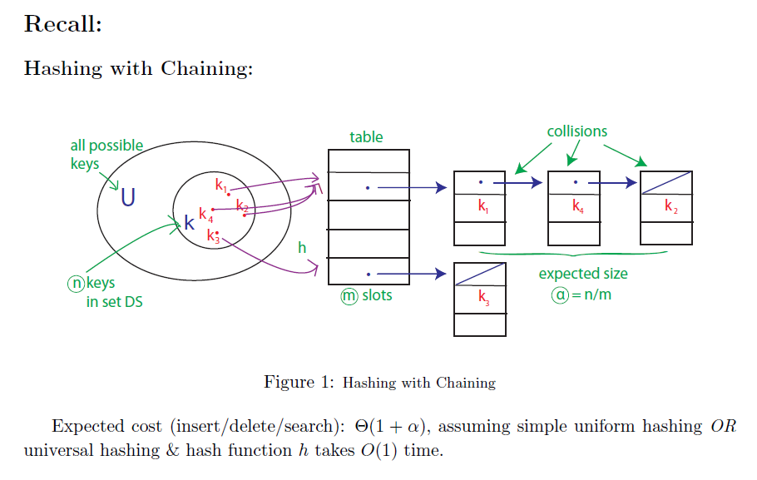
θ(α)

Slide 3
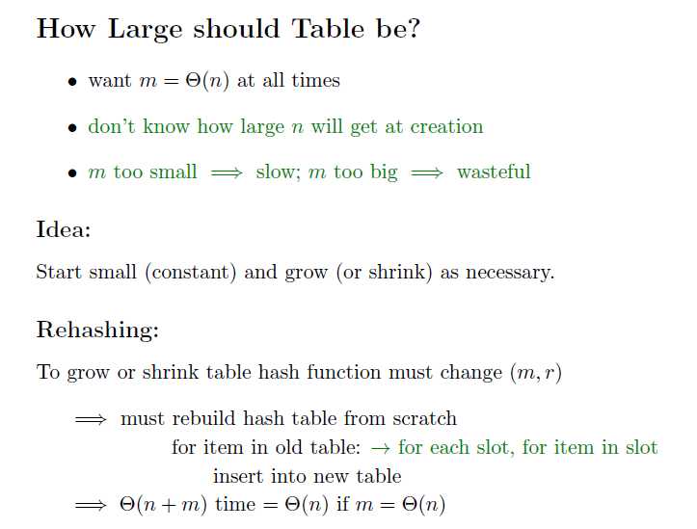

Slide 4
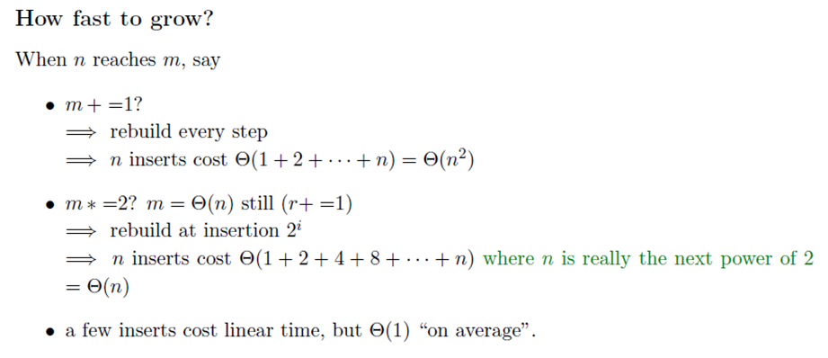

Slide 5
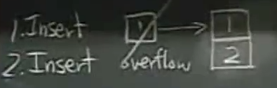
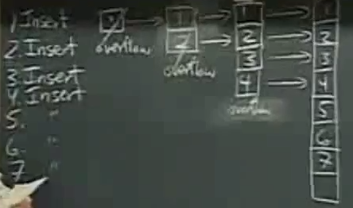
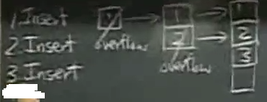

Slide 6
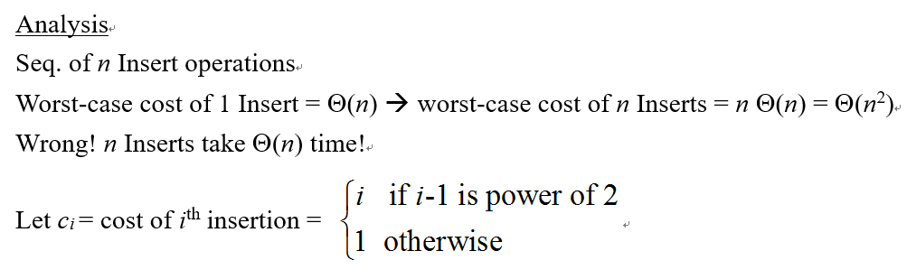
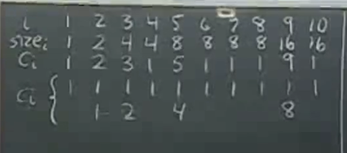
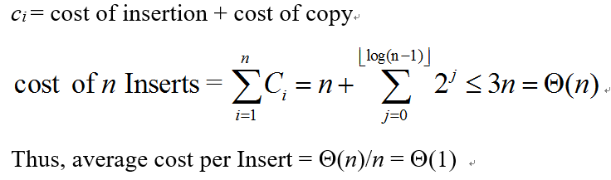
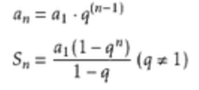
Notes:
总共有flooring(log(n-1))+1项
immediate

Slide 7
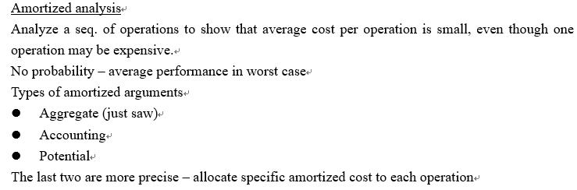
Notes:
aggregate [ˈægrɪgət] accounting [əˈkaʊntɪŋ]

Slide 8
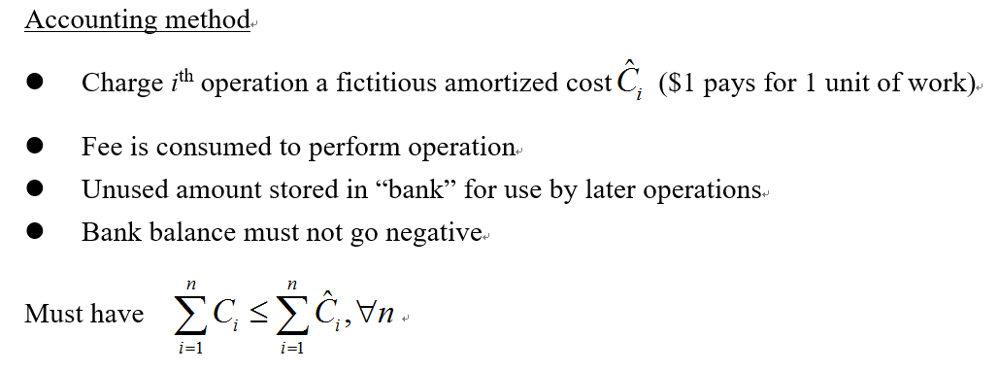
Notes:
Fictitious [fɪkˈtɪʃəs] consume [kənˈsju:m] assume [əˈsju:m]

Slide 9
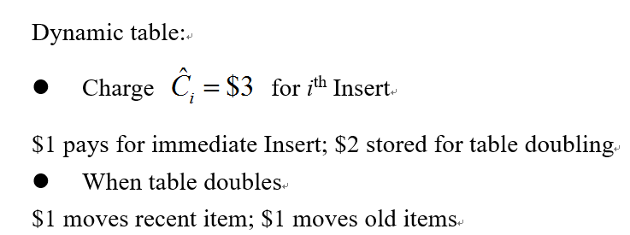
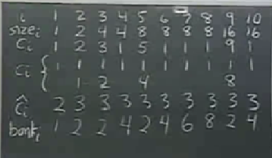

Notes:
Bank’=bank+c^-c

Slide 10
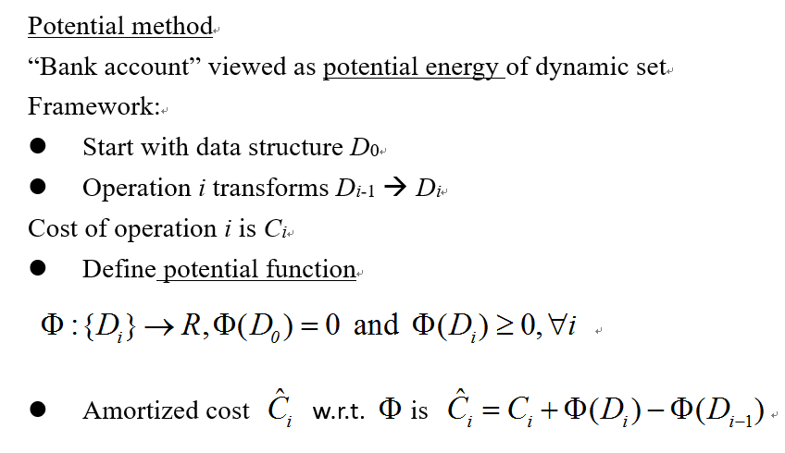

Slide 11
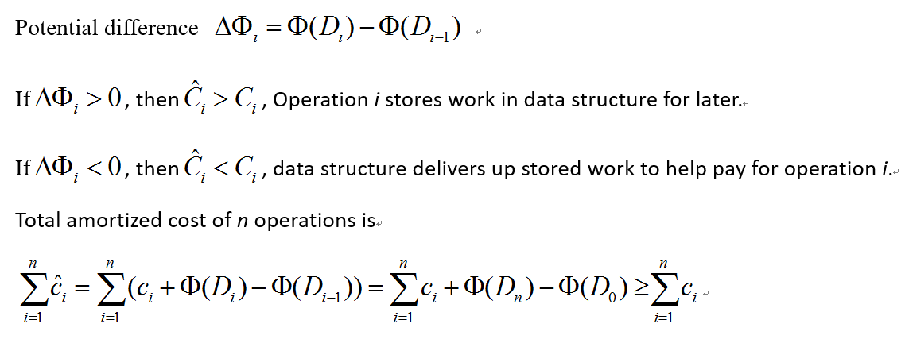
Notes:
telescope

Slide 12
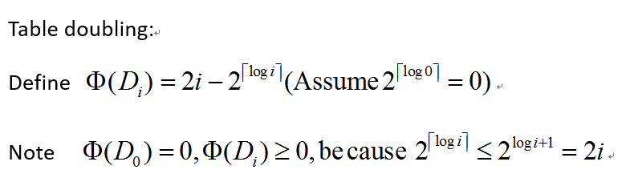
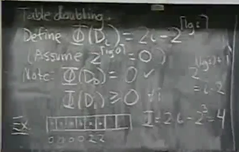
Notes:
Bank=delta

Slide 13
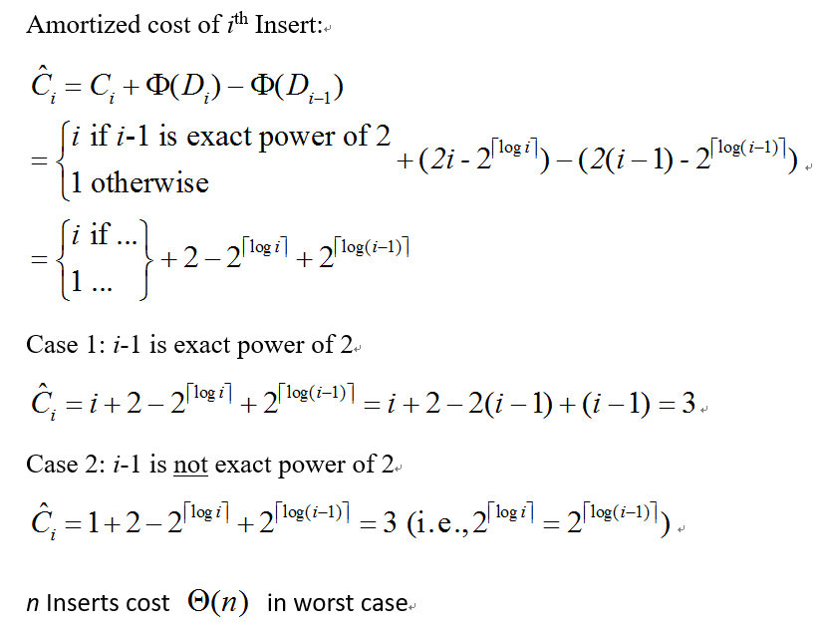

Notes:
Ceiling(logi)=log(i-1)+1, exact power

Slide 14
